Slide 2
Guess
Lead-in
1
1
Do you know what municipal solid waste is?
2
Can you provide some examples?

Slide 3
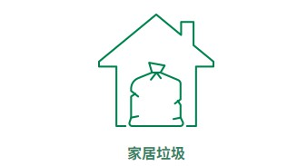
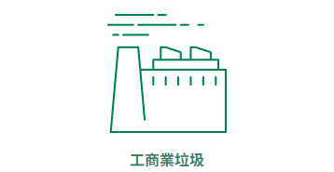
Guess
1
Municipal solid waste (MSW) :
Source
Domestic waste
Commercial and industrial sector waste
Waste from households and institutional premises (e.g. schools)
Waste generated from daily activities
Waste from shops, restaurants, hotels, offices, and markets
Waste generated from all industrial activities
Newspapers, personal care product bottles, beverage bottles, aluminium cans, sauce bottles, household appliances, food waste, etc.
Office paper, cardboard, spoiled / expired food, cardboard boxes, styrofoam, textiles, wood, rubber tires, etc.
Example

Slide 4
Guess
2
Do you know which category of municipal solid waste had the highest disposal amount in Hong Kong in 2022?

Slide 5
2
Guess
Ans: Food waste (30%)
Food waste is any waste, whether raw, cooked, edible and associated with inedible parts generated during food production, distribution, storage, meal preparation or consumption of meals
Component of municipal solid waste disposed of at landfills in 2022
Glass
2%
Paper
20%
Plastics
21%
Metals
2%
Food waste
30%
Others
25%
Total quantity disposed
4.06 million tonnes
Notes:
Note: “Others” include yard waste, textiles, wood, household hazardous wastes, bulky items, and miscellaneous waste materials.

Slide 6
The major constituent of municipal solid waste in Hong Kong: Food waste
Think about it
Do you know the main sources of food waste?

Slide 7
The major constituent of municipal solid waste in Hong Kong: Food waste
About two-thirds from households, one-third from commercial and industrial sources
Disposal of total solid waste at landfills in 2022
Households (21%)
Different sectors of the community and the public throw away about
3 300 tonnes of food waste every day, which is equal to
2 300 tonnes
Commercial and industrial (9%)
1 000 tonnes
Food waste
30%
Other wastes
70%
Apples
20 000 000
Sushi
144 000 000
Mooncakes
20 000 000
Total
3 300 tonnes

Slide 8
The major constituent of municipal solid waste in Hong Kong: Food waste
Think about it
What problems does disposing of food waste at landfills cause?

Slide 9
The major constituent of municipal solid waste in Hong Kong: Food waste
Causes adverse effects on the environment
Occupies valuable landfill space and generates odours
Not sustainable
Requires further proper treatment of leachate and greenhouse gases
Wastes useful organic materials within
What steps should be taken to address the food waste issue in Hong Kong?

Slide 10
Food waste management strategies in Hong Kong
Let's explore Hong Kong’s food waste management strategies!

Slide 11
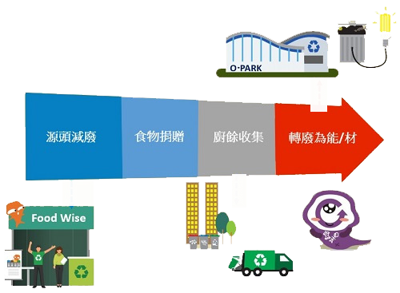
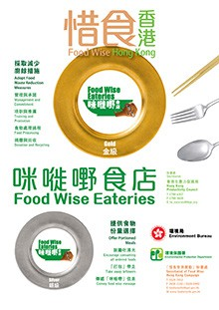
Food waste management strategies in Hong Kong
Three steps of food waste management
Waste reduction at source
Food waste collection
Waste-to-energy /
resources

Slide 12
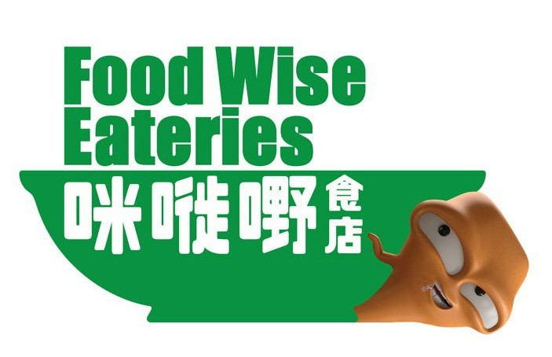
Food waste management strategies in Hong Kong
Three steps of food waste management
1. Waste reduction at source
Through various schemes and activities, e.g. Food Wise Charter, Food Wise Eateries Scheme, and publicity of the Big Waster, promotes a “Food Wise, Waste Less” culture, prevents and reduces food waste at source
Encourages commercial sector to donate surplus food to charity, and supports non-governmental organisations in implementing food recovery projects, under which surplus food is collected from the commercial sector and donated to the needy

Slide 13
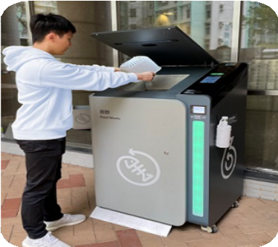
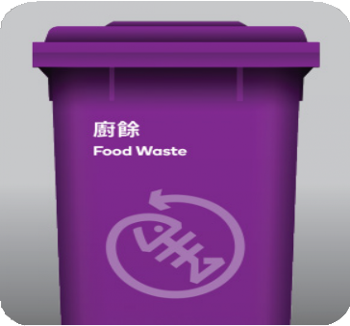
Food waste management strategies in Hong Kong
Three steps of food waste management
2. Food waste collection
Source separation and recycle to gainful resources
盡量從源頭分類及回收再造，轉化為有用資源
3. Waste-to-energy / waste-to-resources
Organic Resources Recovery Centre (O·PARK)
First trial scheme on the food waste / sewage sludge anaerobic co-digestion launched at Sewage Treatment Works

Slide 14
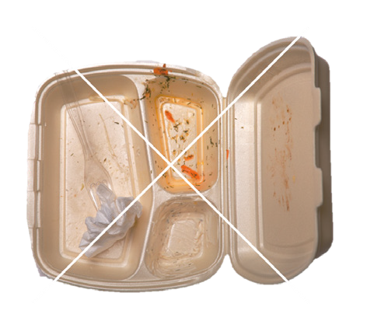
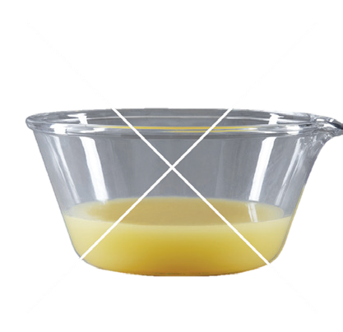
Distinguish between recyclable & non-recyclable food waste
YES
NO
Raw
Cooked
Spoiled
Non Food Waste
Watery Food
Leftover
Citizens can try to use reusable containers to contain food waste for recycling. If necessary, you can also use plastic bags to contain food waste and put it into the food waste recycling bin.
If you cannot recycle the food waste on that day, food waste can be temporarily refrigerated to reduce odour

Slide 15
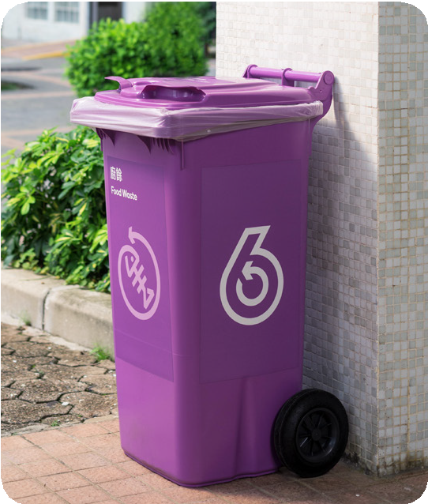
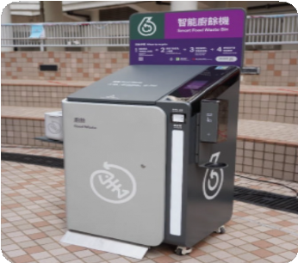
Traditional food waste recycling bins vs Smart food waste recycling bins
Traditional food waste recycling bins
Multiple food waste recycling bins can be arranged for residents' convenience
Not limited by power supply equipment and environmental factor
Shorter approval time for applications
Smart food waste recycling bins
Equipped with advanced deodourisation system and automatic reminders for bin replacement
Requires connection to power source and good communication network coverage
Earn GREEN$ by recycling

Slide 16
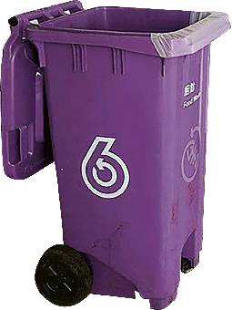
Steps for domestic food waste recycling
Step 1
Step 2
Step 3
Step 4
Use a small container to bring food waste to collection point
Pour food waste into food waste recycling bin
Remove non-food waste
Drain liquid

Slide 17
Food waste management strategies in Hong Kong
Guess
Do you know where the food waste goes after being dropped into the recycling bin?

Slide 18
Organic Resources Recovery Centre Phase 1 (O·PARK 1)
Locating at Siu Ho Wan of North Lantau
A design capacity of 200 tonnes of food waste per day
Adopts anaerobic digestion technology to convert food waste into biogas for electricity generation
The residues from the process can be produced as compost for landscaping and agriculture use
Notes:
https://www.opark.gov.hk/upload/Videos/EA%20Panel%20(Jul)/20231010_chi.mp4

Slide 19
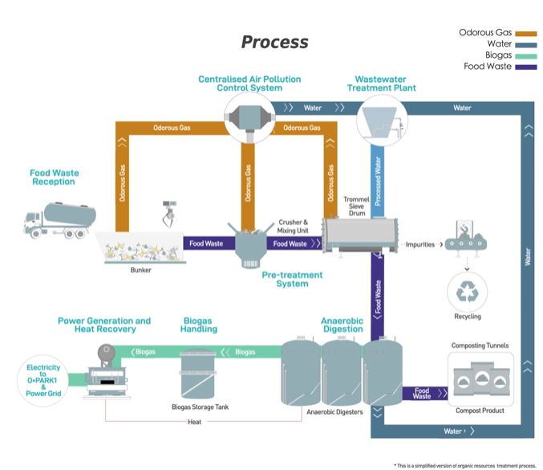
Organic Resources Recovery Centre Phase 1 (O·PARK 1)
Notes:
https://www.opark.gov.hk/tc/process.php

Slide 20
Group discussion
Please discuss in groups on the methods to reduce food waste and benefits of recycling food waste

Slide 21
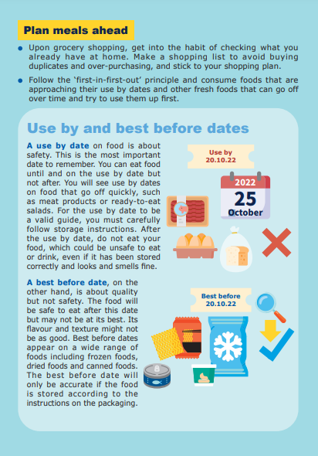
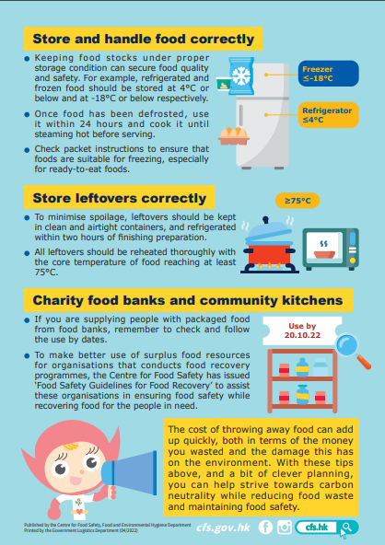
Methods to reduce food waste

Slide 22
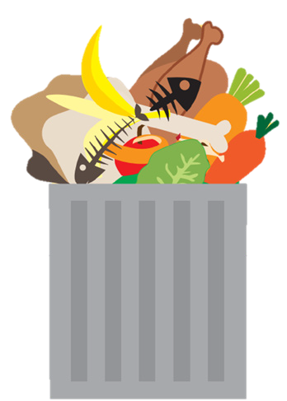
Benefits of recycling food waste
1
Separating food waste from garbage prevents odour and improves environmental hygiene
2
Does not occupy landfill space and aligns with sustainable development principles
3
Fully utilises organic resources

Slide 23
Conclusion
Let’s learn about waste reduction!
Three steps of food waste management
減廢知多啲！
Waste-to-energy / Waste-to-resources
Benefits of recycling food waste

