Slide 2
Common domestic waste and waste separation
1
Have you seen these domestic waste at home?
2
How would you deal with them?

Slide 3
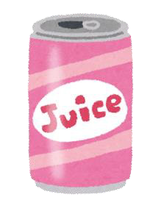
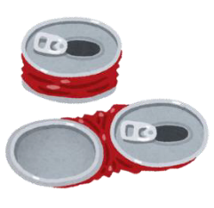
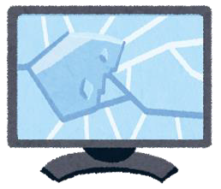
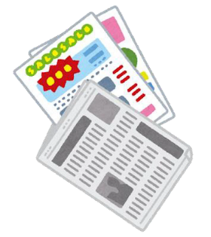
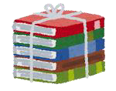
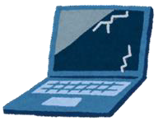
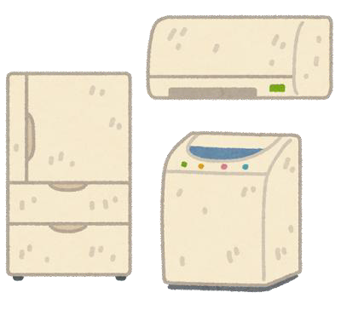
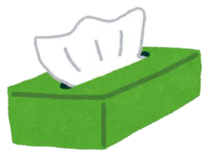
1
Examples of domestic waste
Notes:
Recyclables: Tin cans / aluminium cans, milk cartons, general small household electrical appliances (e.g. hair dryers), newspapers, regulated electrical equipment (REE) (e.g. televisions, computers, monitors, refrigerators, washing machines, tumble dryers, air-conditioners) Non-recyclables: Photos, non-stick pans, tissue / hand towels

Slide 4
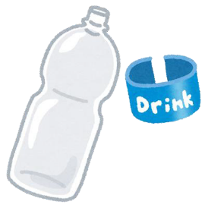
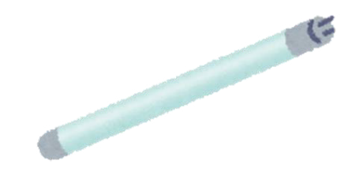
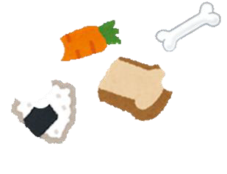
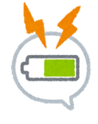
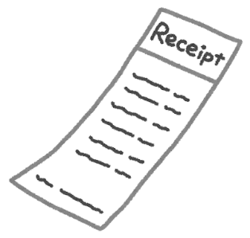
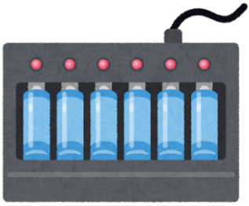
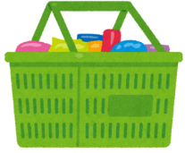
2
Examples of domestic waste
Notes:
Recyclable: Personal care product bottles / beverage plastic bottles, fluorescent lamps and tubes, general small household electrical appliances (e.g. vacuum cleaners), CDs, food waste, portable rechargeable batteries, plastic bags Non-recyclable: Composite materials (e.g. plastics with metals - suitcase), thermal paper (receipts)

Slide 5
Recyclables cards
Paper
Plastics
Metals
Glass Bottles
Regulated Electrical Equipment (REE)
Fluorescent Lamps & Tubes
Small Electrical Appliances
Rechargeable Batteries
Food Waste
Beverage Cartons

Slide 6
Sources of waste and principles of waste reduction
Think about it
1
What other types of waste do we generate in our daily lives?
How can we reduce waste?
2

Slide 7
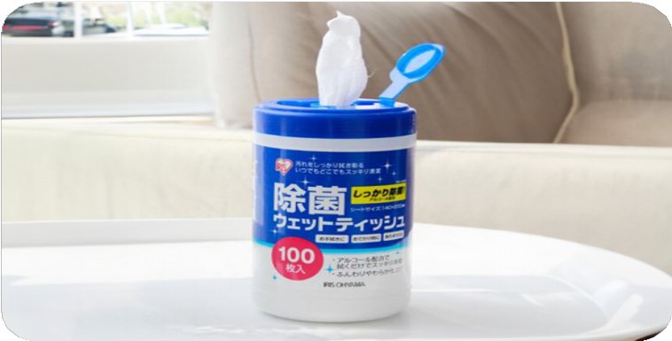
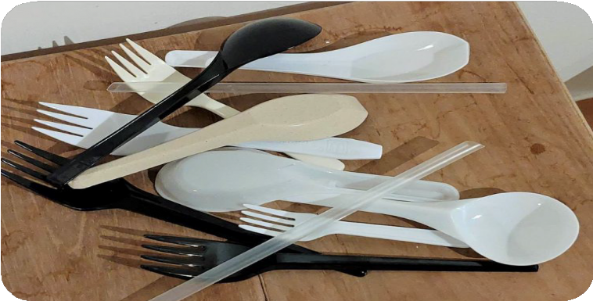
Sources of waste and principles of waste reduction
Think about it
Necessary? Not necessary?
Disposable disinfecting wipes
Disposable tableware

Slide 8
Primary 1
Know about Waste Reduction and Recycling
2. Sources of waste and principles of waste reduction
Waste management hierarchy
Priority to do
Reduce
Level 1
Minimise the use of unnecessary items or energy
Reuse
Reuse items before they become waste
Level 2
Replace
Use environmentally friendly items
Level 3
Recycle
Separate waste for recycling and turning them
into different recycled materials items
Level 4
Disposal
Last

Slide 9
4R principles
Reuse
Recycle
Reduce
Replace

Slide 10
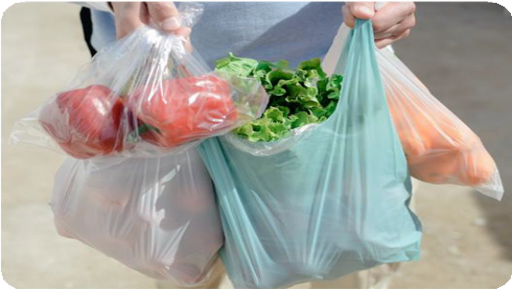
4R principles - Reduce
Minimise the use of unnecessary items or energy
For example :
⮕ Bring your own bags to reduce the use of plastic bags
⮕ Bring your own water bottles to reduce the purchase of beverage plastic bottles
Reduce

Slide 11
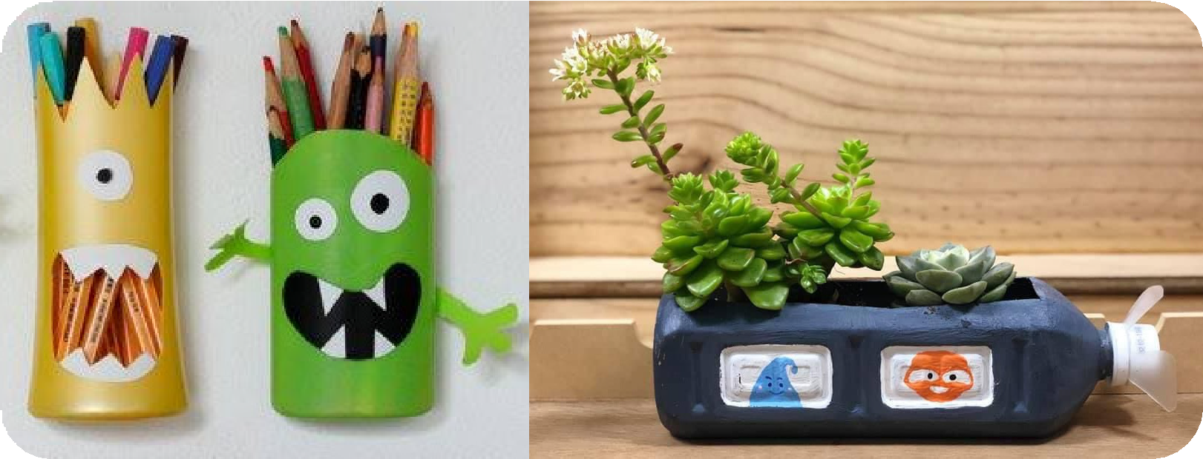
4R principles - Reuse
Reuse items before they become waste
Reuse
For example :
⮕ Write on both sides of papers
⮕ Reuse various types of plastic bottles

Slide 12
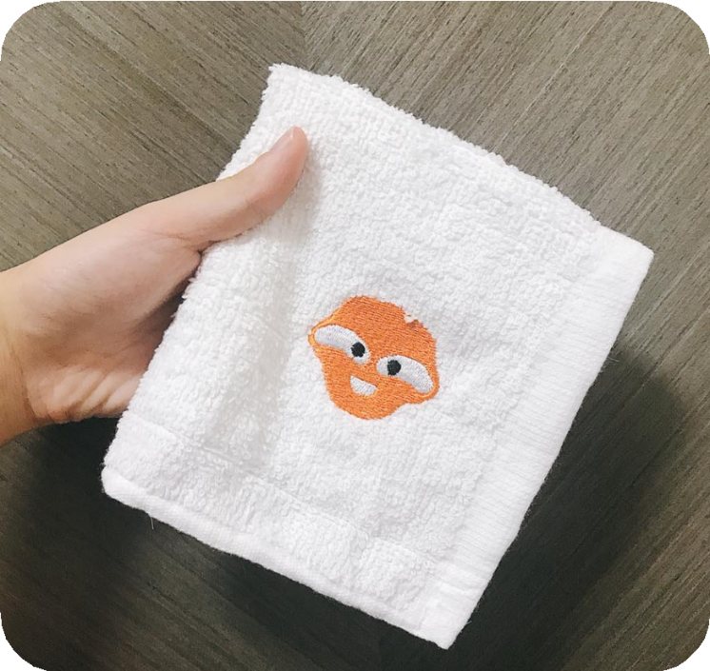
4R principles - Replace
Replace
Use environmentally friendly items
For example :
⮕ Bring your own towels instead of tissue

Slide 13
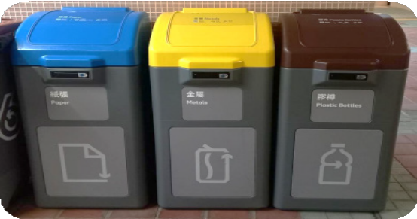
4R principles - Recycle
Recycle
Separate waste for recycling and turning them into different recycled materials items
For example :
⮕ Recycle papers and turning it into recycled paper

Slide 14
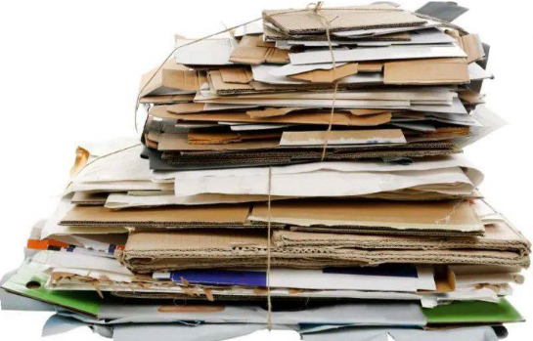
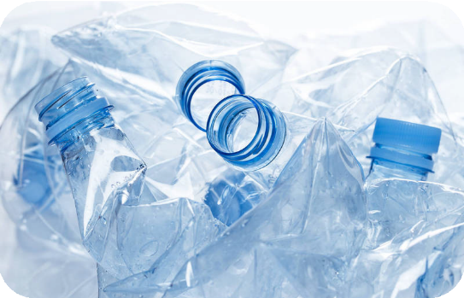
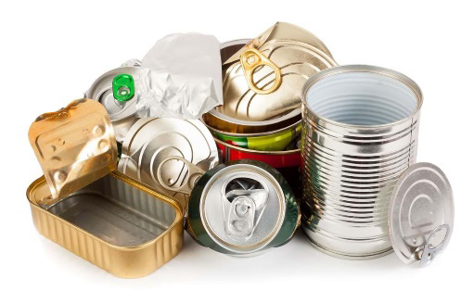
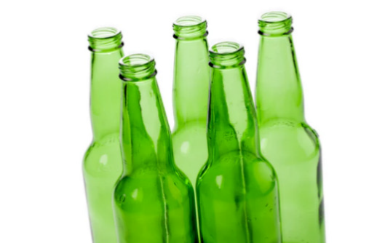
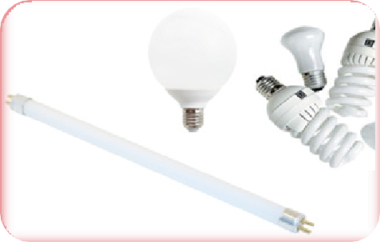
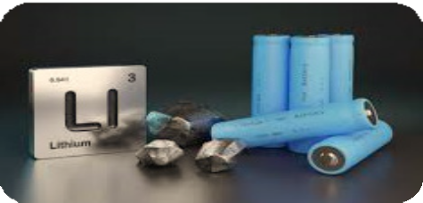
Common recyclables
Paper
Plastics
Metals
Glass Bottles
Fluorescent Lamps & Tubes
Rechargeable
Batteries

Slide 15
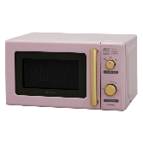
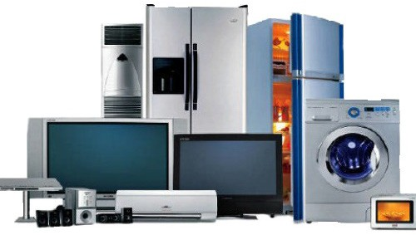
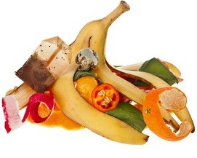
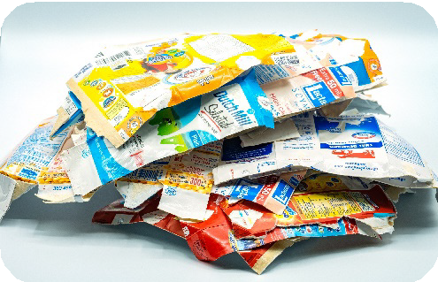
Common recyclables
Small Electrical Appliances
Beverage Cartons
Regulated Electrical Equipment (REE)
Food
Waste

Slide 16
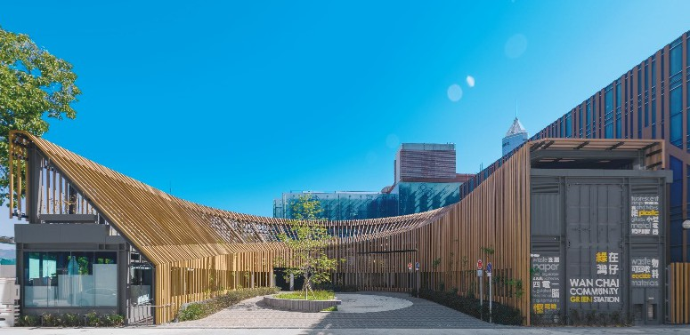
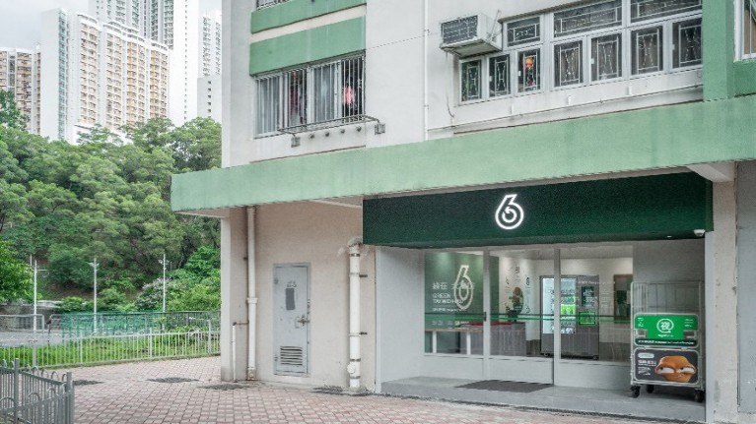
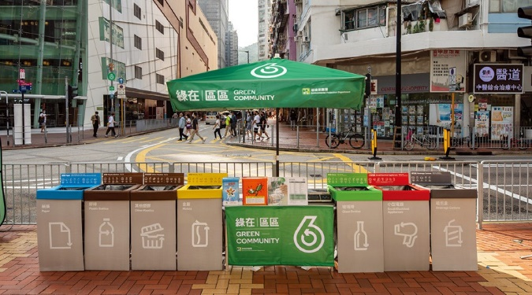
Community recycling facilities
Recycling Stations
Recycling Stores
Recycling Spots
Provide environmental education and recycling support
Located near single-block buildings or in public rental housing estates with large population
Mobile collection booths operating at fixed time and locations
44

Slide 17
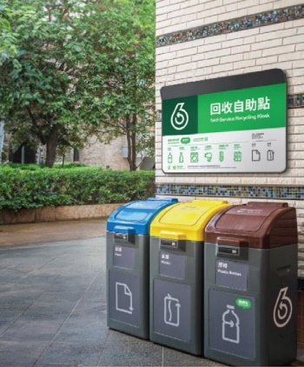
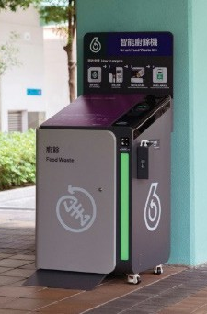
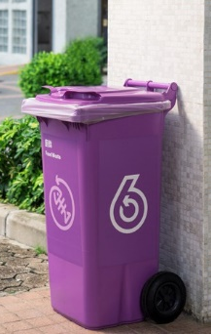
Other recycling facilities
Recycling bins in
housing estates
Kerbside Recycling Bins
Smart Recycling Bins
Food Waste Recycling Bins
Located on floors or public places of housing estates
Mostly located in rural areas
Self-service recycling and earn GREEN$ for gift redemption
Located in all public rental housing estates, and public food waste recycling points
44

Slide 18
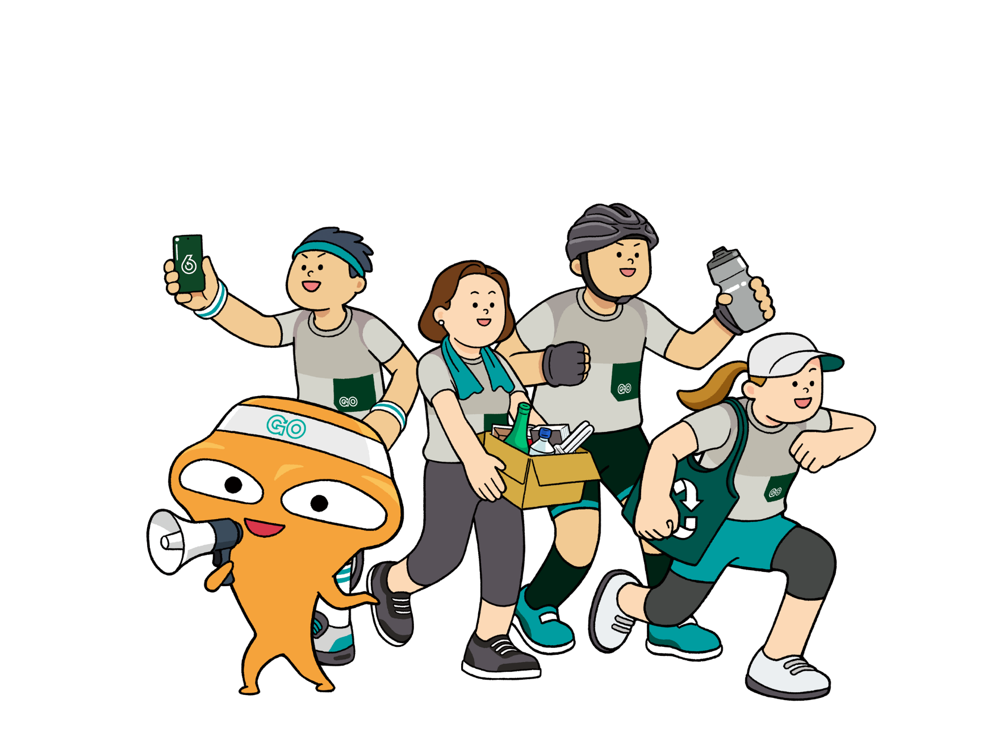
Conclusion
Let’s learn about waste reduction!
減廢知多啲！
4R principles
Common recyclables and recycling facilities
Common domestic waste

